Slide 1
LeNet-5 Models for Handwriting Recognition Based on Pynq-Z1
Presented by: Longhao Tan, Mohamed Tajudeen Sunaideen

Slide 2
Overview
This project involves deploying the LeNet-5 CNN on the PYNQ-Z1 platform, utilizing its FPGA capabilities to achieve efficient hardware-accelerated inference with improved performance for edge AI applications.

Slide 3
Motivation
Exploration of Edge AI: Pynq-z1 is a resource limited device. Running LeNet-5 model on edge devices can demonstrate the potential of deploying deep learning model on limited devices.
Hardware Acceleration: Leveraging the FPGA capabilities of the PYNQ-Z1 enables full utilization of hardware acceleration, enhancing performance and scalability for AI applications.
Provides a practical case to use FPGA to accelerate the machine learning model on edge devices, combining the software with hardware for embedded AI systems.

Slide 4
Goals
Model Deployment: Train and quantize LeNet-5 model with MNIST dataset to fit the constraints of the PYNQ-Z1 and deploy the optimized model on it.
FPGA Acceleration Design: Implement a hardware pipeline that accelerates LeNet-5’s operations by using FPGA resources.
Verification: Evaluate the deployed model’s accuracy, inference time on the PYNQ-Z1.

Slide 5
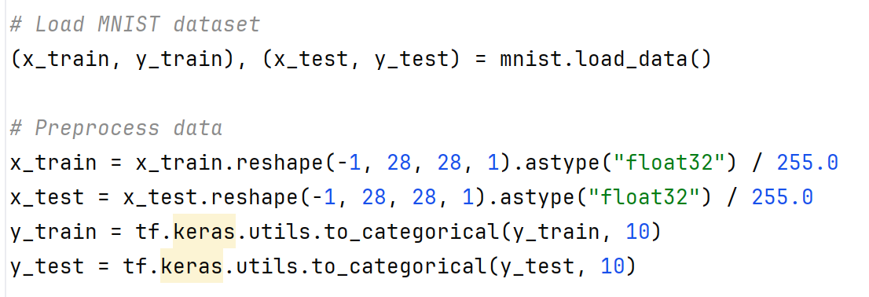
Model Training
1. Training LeNet-5 model with MNIST training dataset

Slide 6
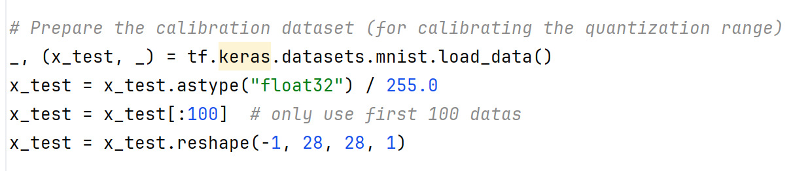
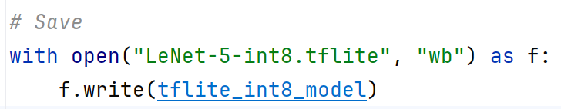
Model Training
2. Quantize model with part of test datasets in MNIST

Slide 7
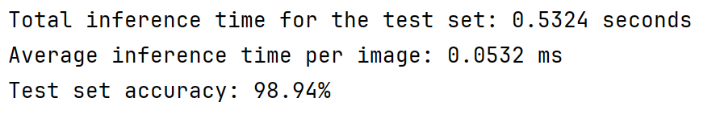
Model Training
3. Inference time testing

Slide 8
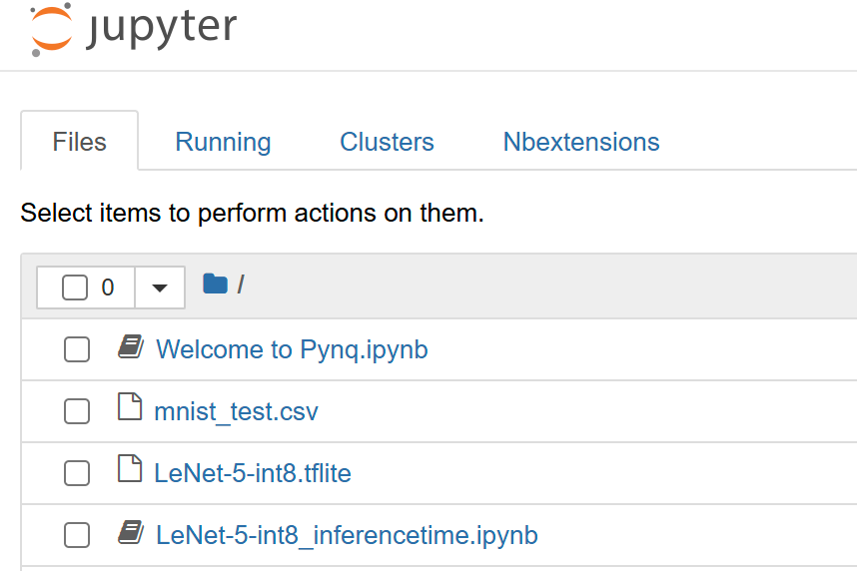
Model Deployment
Main steps for preparation:
Flash the PYNQ-Z1 image onto a Micro SD card
Connect cable and run PYNQ-Z1
Open Jupyter notebook in 192.168.2.99
Upload and install required dependencies such as suitable version of NumPy and tflite_runtime framework
Upload MNIST test dataset

Slide 9
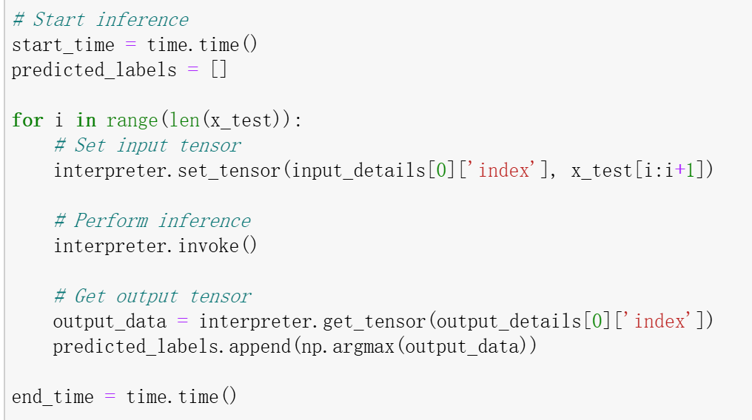
Model Deployment: without acceleration

Slide 10
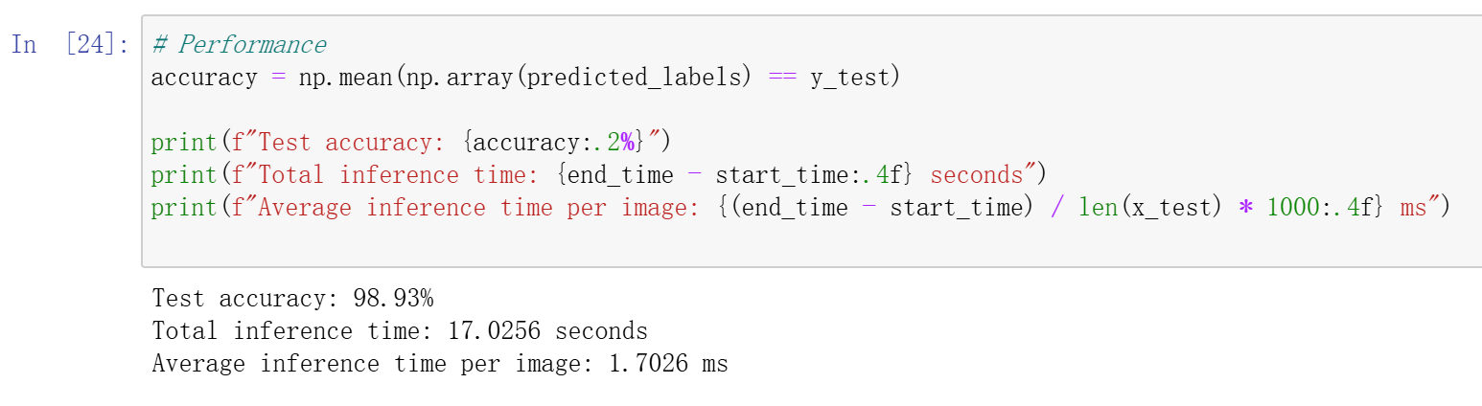
Model Deployment: without acceleration

Slide 11
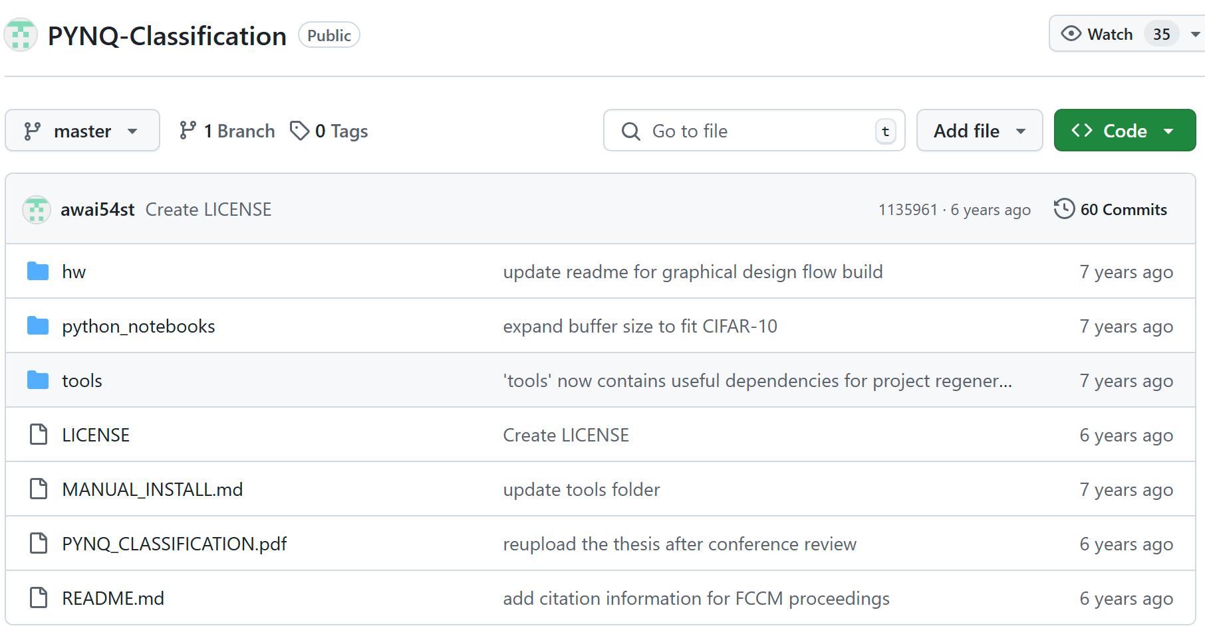
Model Deployment: with acceleration

Slide 12
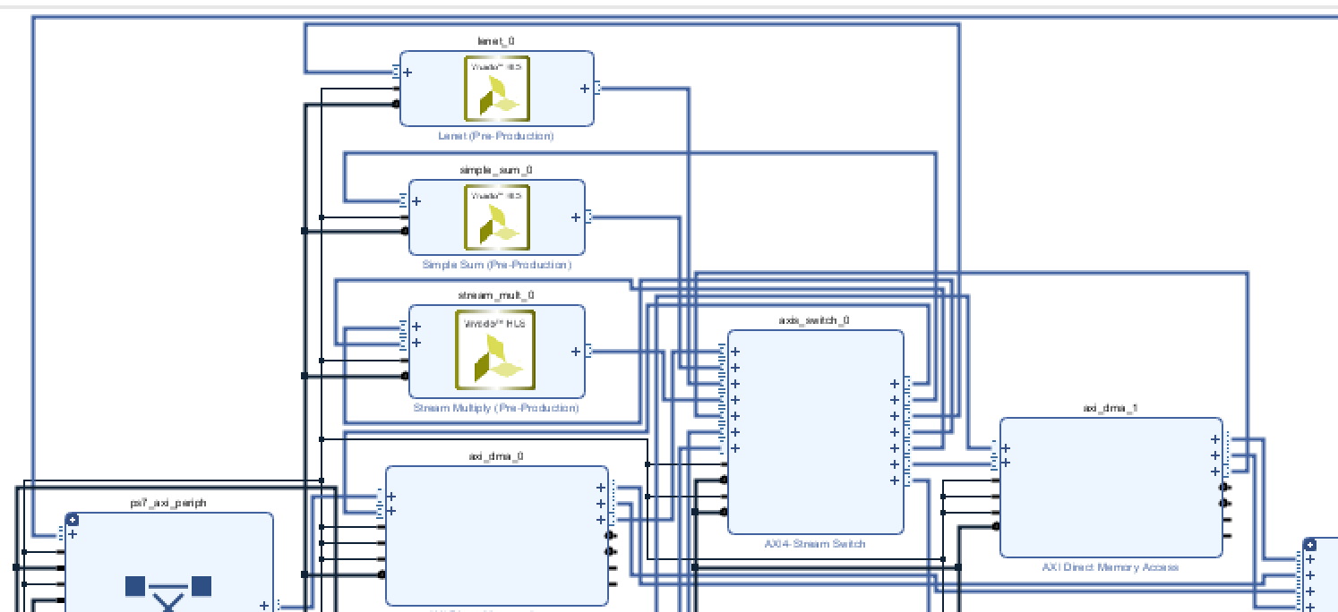
Model Deployment: with acceleration
Pre-designed tcl file is used by Vivado HLS for scripting and automating FPGA design workflows. Then run Synthesis, Implementation and Bitstream Generation to generate a bitstream file to configure FPGA.

Slide 13
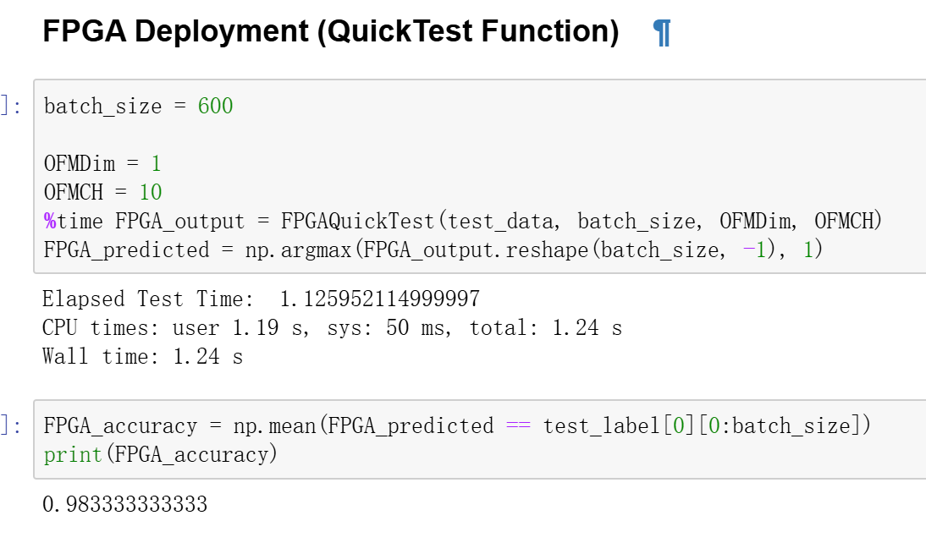
Model Deployment: with acceleration

Slide 14
Conclusion
Quantized deep learning LeNet-5 model has the potential to be deployed on edge devices and finish handwriting recognition tasks with high efficiency and accuracy.
Only relying on the processor of PYNQ, the performance is limited.
The inference time decreases a lot with good designation of FPGA.

Slide 15
Q&A

